Slide 1
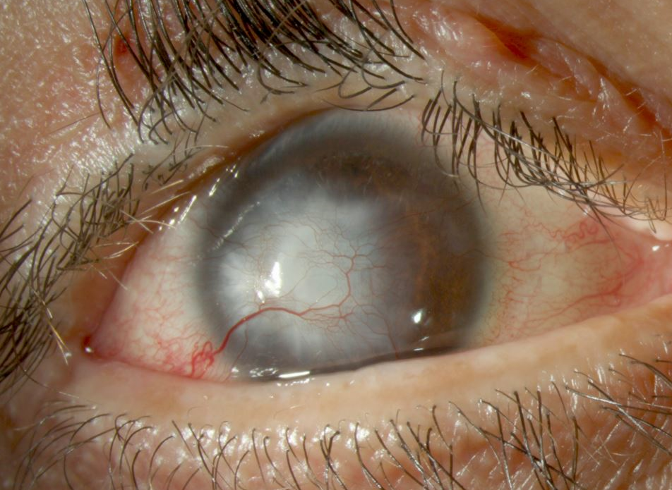
Management of Bilateral Lipid Keratopathy
Masako Chen, MD
Cornea and External Diseases Fellow
Bascom Palmer Eye Institute
Faculty Discussant: Rahul Tonk, MD

Slide 2
No financial disclosures

Slide 3
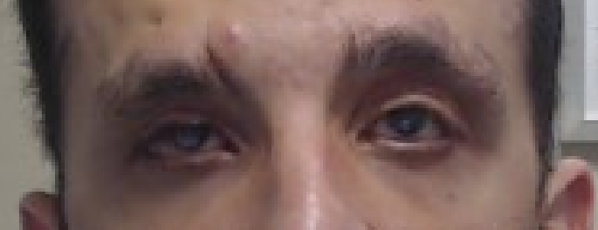
Initial Presentation
36 yo M blurry vision OD>OS x 2 years
PMH: Marfan’s Syndrome
POH: congenital ptosis s/p frontalis slings, entropion, multiple eyelid surgeries

Slide 4
RIGHT EYE
BCVA E at 1 Foot
3 mm lagophthalmos

Slide 6
LEFT EYE
BCVA 20/60 with corneal GP lens

Slide 8
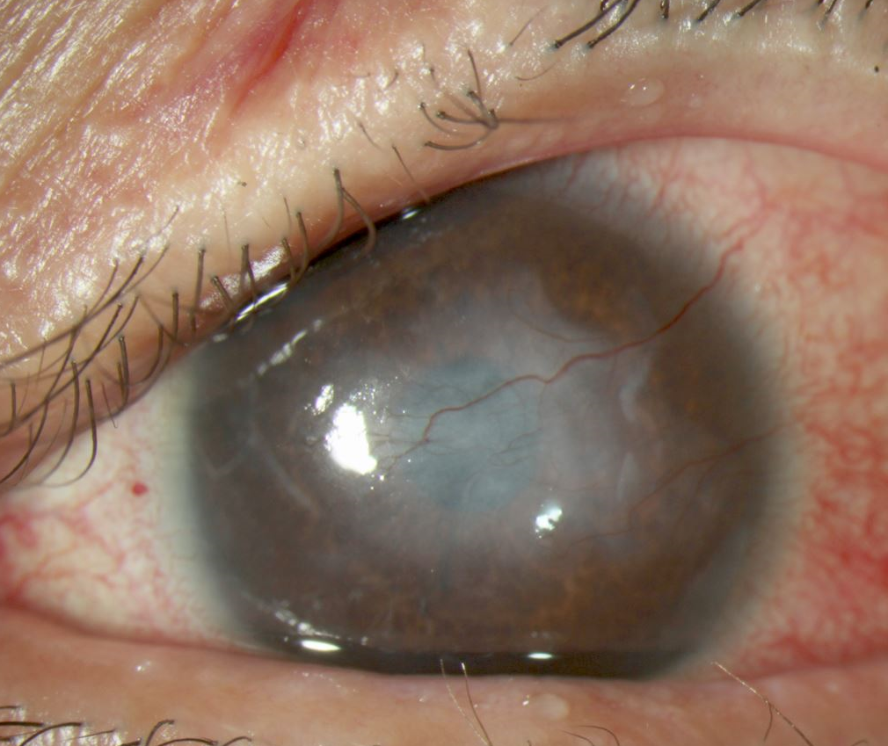
BCVA E at 1 Foot
BCVA 20/60

Slide 9
What’s Going On?
Exposure Keratopathy
Corneal Neovascularization
Corneal Opacification

Slide 10
Panel: What would you do?

Slide 11
Treatment Options
Exposure Keratopathy
Corneal Neovascularization
Corneal Opacification
Topical Steroids
Anti-VEGF
Argon laser
Fine Needle Diathermy
Mitomycin intravascular chemoembolization (MICE)
Photodynamic Therapy
Crosslinking
Scleral contact lens
PTK
FALK/DALK
PK
Oculoplastics referral

Slide 12
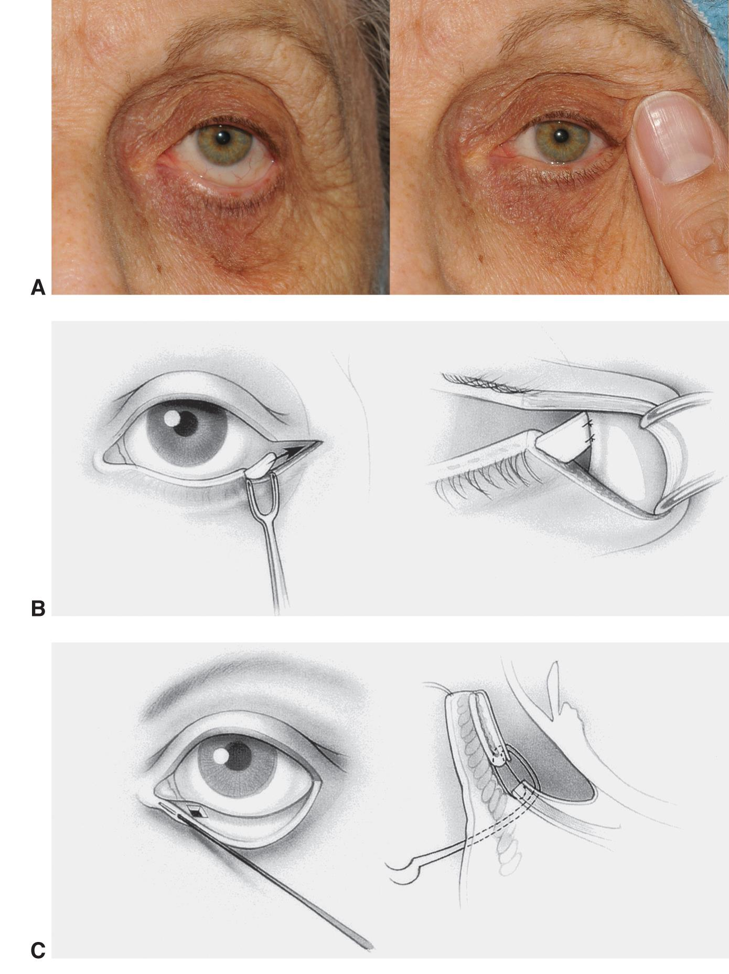
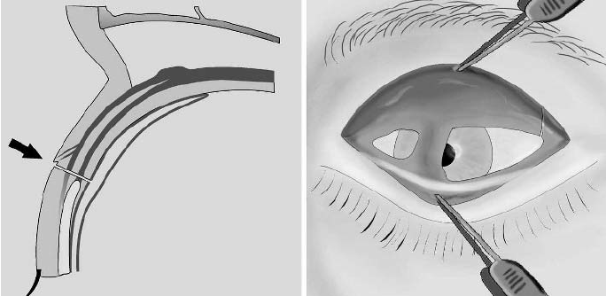
Repair of lid retraction through blepharotomy with upper and lower lateral tarsal strip right eye
Right:https://www.researchgate.net/publication/7959853_Full_thickness_eyelid_transsection_blepharotomy_for_upper_eyelid_lengthening_in_lid_retraction_associated_with_Graves%27_disease/figures?lo=1
Left Image: https://www.aao.org/image/lateral-tarsal-strip-procedure-2

Slide 13
Start with the left eye

Slide 14
Effects of Subconjunctival Bevacizumab on Corneal Neovascularization: Results of a Prospective Study Benayoun Y, Adenis J, Casse G, Forte R, Robert P. Cornea 2012;31:937–944
Before
After

Slide 15
Corneal angiography for guiding and evaluating fine-needle diathermy treatment of corneal neovascularization Spiteri N, Romano V, Zheng Y, Yadav S, Dwivedi R, Chen J, Ahmad S, Willoughby C, Kaye S. Ophthalmology, June 2015

Slide 16
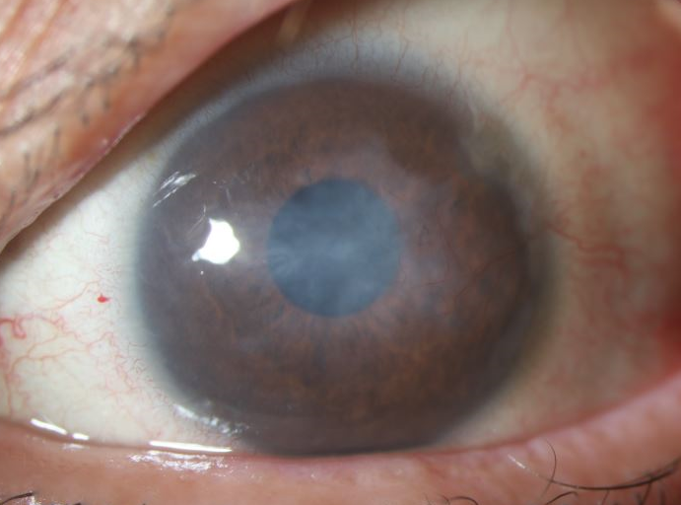
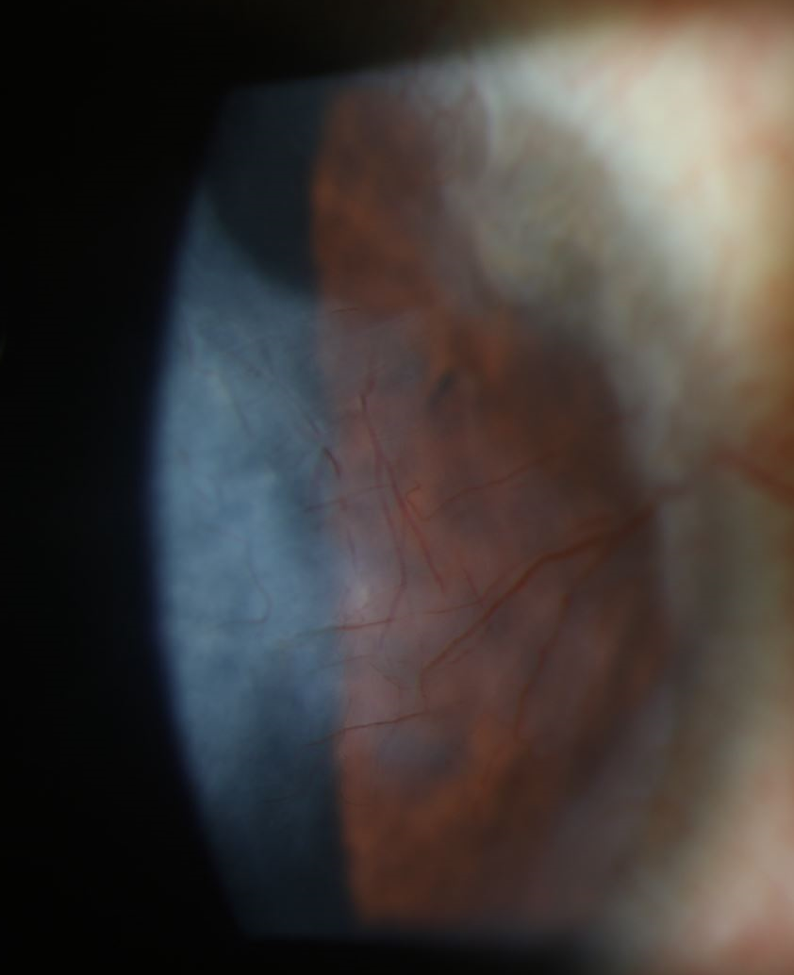
Post fine needle diathermy + subconjunctival bevacizumab and subtenons kenalog
BCVA 20/40 with Scleral

Slide 17
Long-term outcome of using Prosthetic Replacement of Ocular Surface Ecosystem (PROSE) as a drug delivery system for bevacizumab in the treatment of corneal neovascularization Yin J, Jacobs DS, Ocular Surface 2019
Initial: 20/400
4 months: 20/50
7 years: 20/30

Slide 18
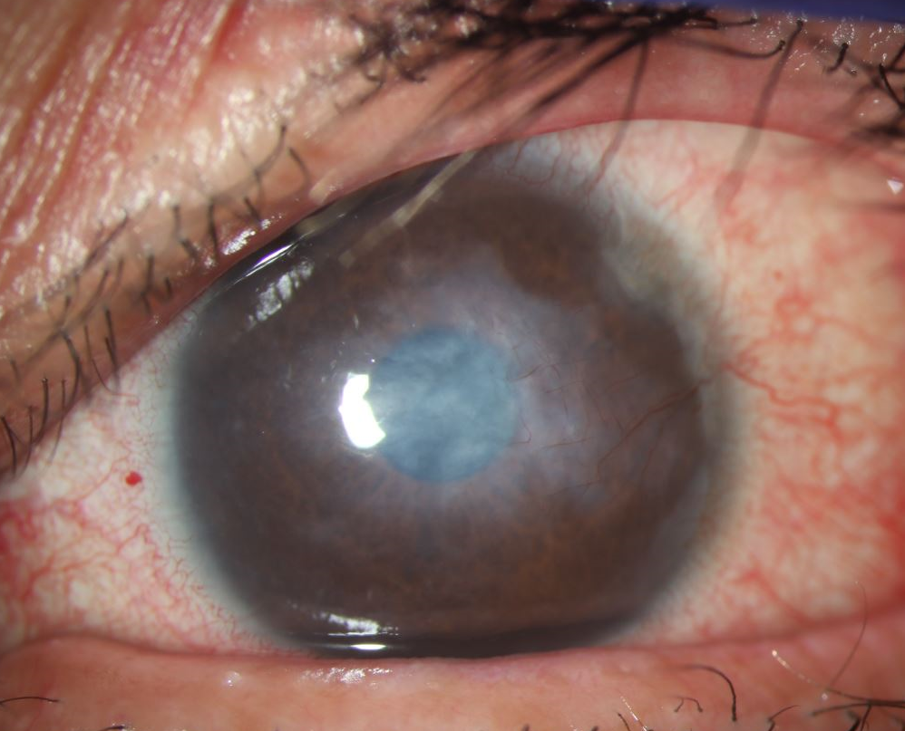
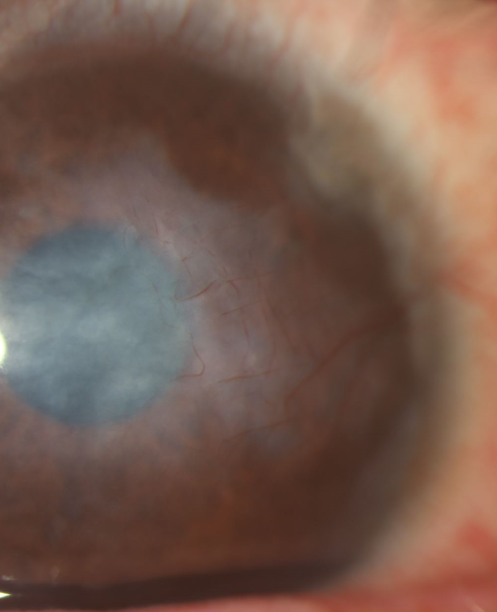
Post topical bevacizumab in scleral lens
BCVA 20/25!

Slide 19
Now the right eye

Slide 20
BACK TO THE RIGHT EYE
BCVA E at 1 foot

Slide 21
5/2019: Fine Needle Diathermy, subconj avastin, superficial keratectomy, AMG

Slide 22
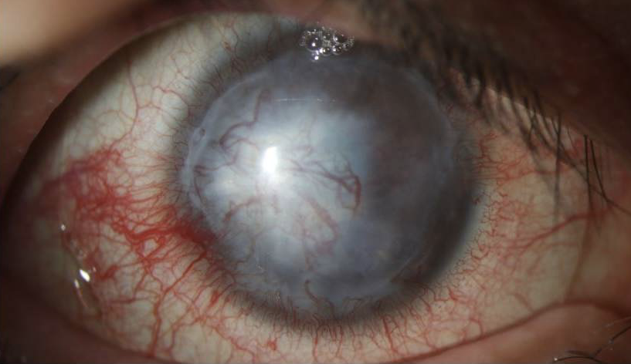
Post fine needle diathermy, subconjunctival avastin, amniotic membrane

Slide 23
5/2019: Fine Needle Diathermy, subconj avastin, superficial keratectomy, AMG
3/2020: DALK + AMG

Slide 24
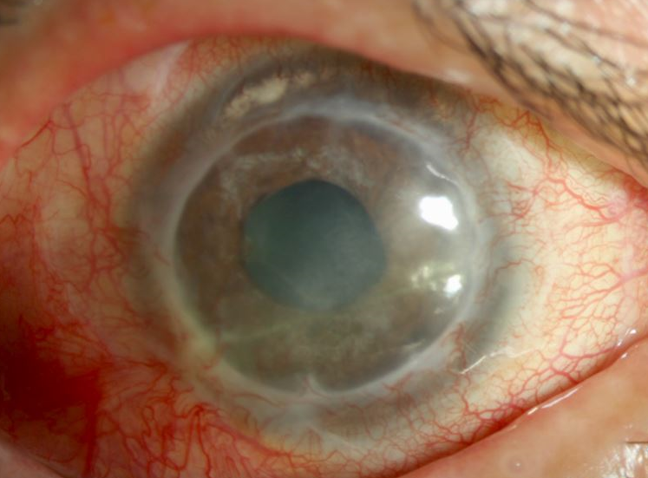
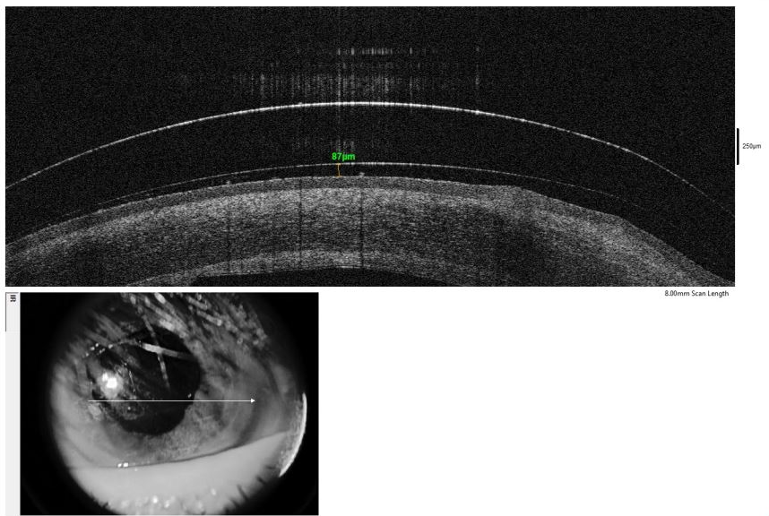
s/p DALK
BCVA 20/200

Slide 25
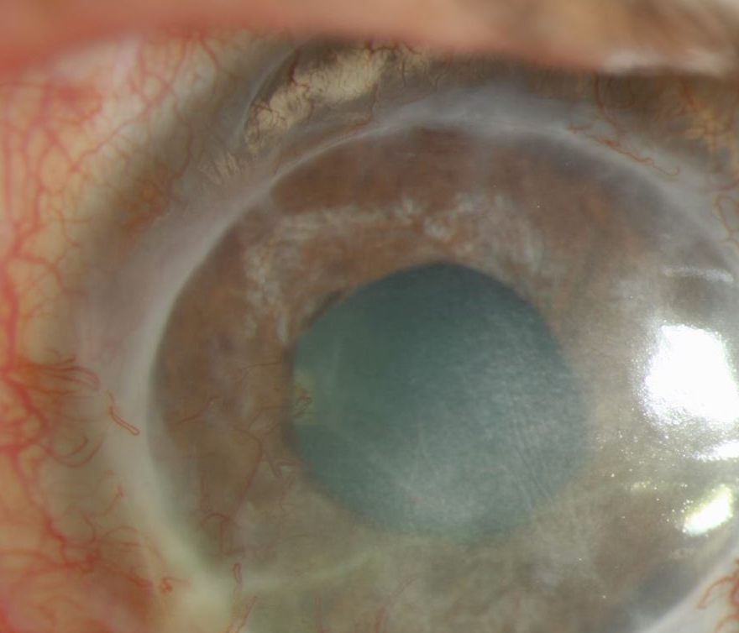

Slide 26
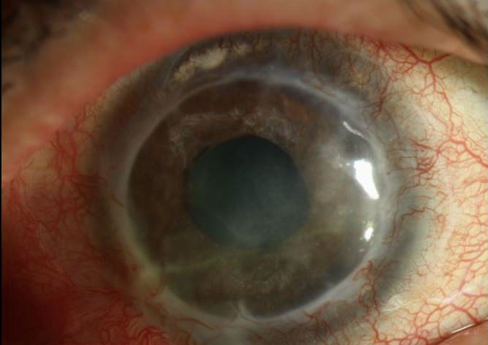
5/2019: Fine Needle Diathermy, subconj avastin, superficial keratectomy, AMG
BCVA: 20/60 with scleral lenses
2/2021: CE/IOL, MMC Chemoembolization
3/2020: DALK + AMG
8/2020: Recurrence of vessels argon laser photocoagulation
BCVA 20/100

Slide 27
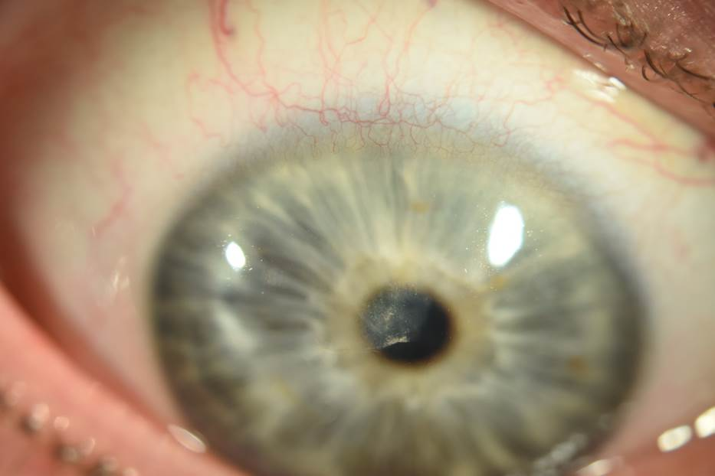
Mitomycin Intravascular Chemoembolization
Presentation
POM6
Images: Dean Ouano, MD

Slide 29
BCVA E at 1 foot
BCVA 20/60
BCVA 20/60
BCVA 20/25

Slide 30
Summary
Corneal neovascularization should be treated prior to keratoplasty to improve graft survival
Anti-VEGF therapy can help treat corneal neovascularization
Mitomycin intravascular chemoembolization is a new technique in treatment of corneal neovascularization, but further studies are necessary

Slide 31
Thank you!
Dr. Rahul Tonk
Dr. Joanne Ho
Dr. Stephanie Frankel
Dr. Chris Alabiad

Slide 32
Questions and Further Discussion

Slide 33
Bibliography
Hall MN, Moshirfar M, Amin-Javaheri A, Ouano DP, Ronquillo Y, Hoopes PC. Lipid Keratopathy: A Review of Pathophysiology, Differential Diagnosis, and Management. Ophthalmol Ther. 2020 Dec;9(4):833-852. doi: 10.1007/s40123-020-00309-y. Epub 2020 Oct 15. PMID: 33058067; PMCID: PMC7708541.
Shiuey EJ, Zhang Q, Rapuano CJ, Ayres BD, Hammersmith KM, Nagra PK, Syed ZA. Development of a nomogram to predict graft survival after penetrating keratoplasty. Am J Ophthalmol. 2021 Feb 5:S0002-9394(21)00061-1. doi: 10.1016/j.ajo.2021.01.030. Epub ahead of print. PMID: 33556382.
Benayoun Y, Adenis JP, Casse G, Forte R, Robert PY. Effects of subconjunctival bevacizumab on corneal neovascularization: results of a prospective study. Cornea. 2012 Aug;31(8):937-44. doi: 10.1097/ICO.0b013e31823f8d71. PMID: 22357391.
Yin J, Jacobs DS. Long-term outcome of using Prosthetic Replacement of Ocular Surface Ecosystem (PROSE) as a drug delivery system for bevacizumab in the treatment of corneal neovascularization. Ocul Surf. 2019 Jan;17(1):134-141. doi: 10.1016/j.jtos.2018.11.008. Epub 2018 Nov 20. PMID: 30468876; PMCID: PMC6340761.
Spiteri N, Romano V, Zheng Y, Yadav S, Dwivedi R, Chen J, Ahmad S, Willoughby CE, Kaye SB. Corneal angiography for guiding and evaluating fine-needle diathermy treatment of corneal neovascularization. Ophthalmology. 2015 Jun;122(6):1079-84. doi: 10.1016/j.ophtha.2015.02.012. Epub 2015 Apr 1. PMID: 25841974.

